Slide 1



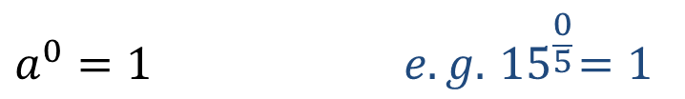
24
7
30
Date
Index Notation
EQ – How do I calculate the value of a number to the power of a positive or negative integer?
What is index notation?
Index or exponent
Base
$$3^{5} =3×3×3×3×3$$
Power Form
or index form
Extended or expanded form
The index shows the number of times the base is multiplied by itself
How to you evaluate a base to the power of one or zero?
$$a^{1}=a e.g. { 12}^{1}=12$$
$$a^{0}=1 e.g. { 12}^{0}=1$$
$$a^{0}=1 e.g. { 15}^{\frac{0}{5}}=1$$
7

Slide 2
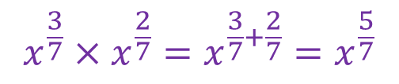

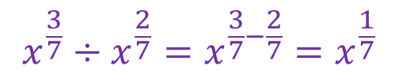
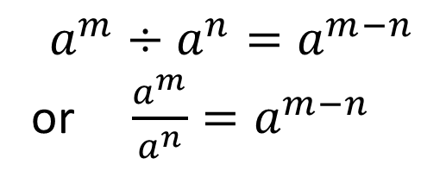
24
7
30
Date
Index Laws
EQ – Describe how the index laws can be used to simplify expressions with indices.
What are the index laws?
Index Law 1
Example
$$a^{m}×a^{n}=a^{m+n}$$
$$x^{\frac{3}{7}}×x^{\frac{2}{7}}=x^{\frac{3}{7}+\frac{2}{7}}=x^{\frac{5}{7}}$$
Index Law 2
$$a^{m}÷a^{n}=a^{m−n}$$
or $\frac{a^{m}}{a^{n}}=a^{m−n}$
$$x^{\frac{3}{7}}÷x^{\frac{2}{7}}=x^{\frac{3}{7}−\frac{2}{7}}=x^{\frac{1}{7}}$$
5

Slide 3
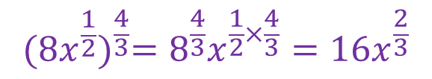
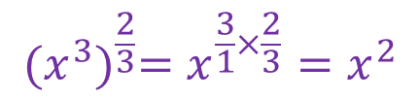
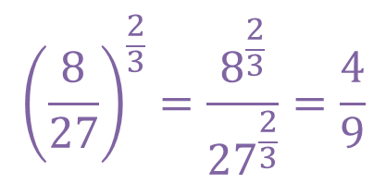

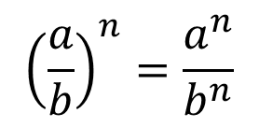
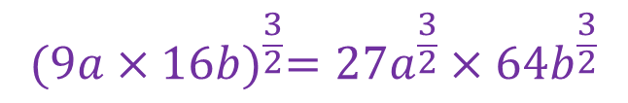

24
7
30
Date
Index Laws
EQ – Describe how the index laws can be used to simplify expressions with indices.
What are the index laws?
Index Law 3
Example
$${(x^{3})}^{\frac{2}{3}}=x^{\frac{3}{1}×\frac{2}{3}}=x^{2}$$
$$({a^{m})}^{n}=a^{mn}$$
$${(8x^{\frac{1}{2}})}^{\frac{4}{3}}={8^{\frac{4}{3}}x}^{\frac{1}{2}×\frac{4}{3}}={16x}^{\frac{2}{3}}$$
Index Law 4
$$({a×b)}^{n}=a^{n}×b^{n}$$
$${(9a×16b)}^{\frac{3}{2}}={27a}^{\frac{3}{2}}×{64b}^{\frac{3}{2}}$$
Index Law 4
$${\left(\frac{a}{b}\right)}^{n}=\frac{a^{n}}{b^{n}}$$
$${\left(\frac{8}{27}\right)}^{\frac{2}{3}}=\frac{8^{\frac{2}{3}}}{{27}^{\frac{2}{3}}}=\frac{4}{9}$$
5

Slide 4

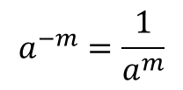


24
7
30
Date
Negative Indices
EQ – Describe the effect of a negative indices on a number.
What is the rule for negative powers?
$$a^{−m}=\frac{1}{a^{m}}$$
$$a^{m}=\frac{1}{a^{−m}}$$
Examples
$$5^{−2}=\frac{1}{5^{2}}=\frac{1}{25}$$
$$a^{−2}b^{4}=\frac{1}{a^{2}}×b^{4}=\frac{b^{4}}{a^{2}}$$
5

Slide 5
Exercises
Exercise 4.7 to 4.10 from Dwyer
All to be done with a smile on your faces.

Slide 6
Notes Review
24, 7 ,30
Date
Title
Essential question
Notes complete
Notes complete with colour and diagrams
Questions completed
Contents page filed in
Formula page filled in

Slide 7
Homework
Review your notes and write a summary answering the essential question.

